Slide 1
BIM technology application for owners
Committed to providing integrated digital construction solutions
重庆市筑云科技有限责任公司
CHONGQING ZHUYUN TECHNOLOGY CO., LTD
Notes:
分析

Slide 2
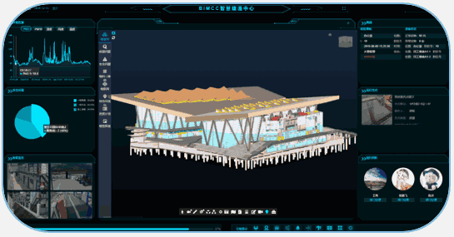
Digital Construction Platform
Submodule: Quality and safety management
Quality and safety inspection + QR code management + safety fixed-point inspection
Submodule: Progress Management
Sub-module: fine management of materials
Panoramic image progress + progress Gantt chart + model-based progress management
Supplier management + material classification + warehousing management + material ledger + material settlement
Submodule: Model Management
Sub-module: Smart construction site
BIM + GIS model + drawing linkage + engineering quantity statistics
Personnel real-name system + personnel positioning + early warning center + AI recognition + panoramic inspection
BIMCC Digital Construction Platform
Based on the BIM model, the owner's construction management platform uses mobile hardware terminals (mobile phones, panoramic cameras, etc.) and Internet of Things technology (RFID technology, infrared thermal sensing technology, wireless network technology, etc.) to collect progress, quality, safety, cost and environmental management data in the construction process in real time, and realizes integration, collaboration and sharing management through the platform; Use database technology to intelligently analyze management data.

Slide 3
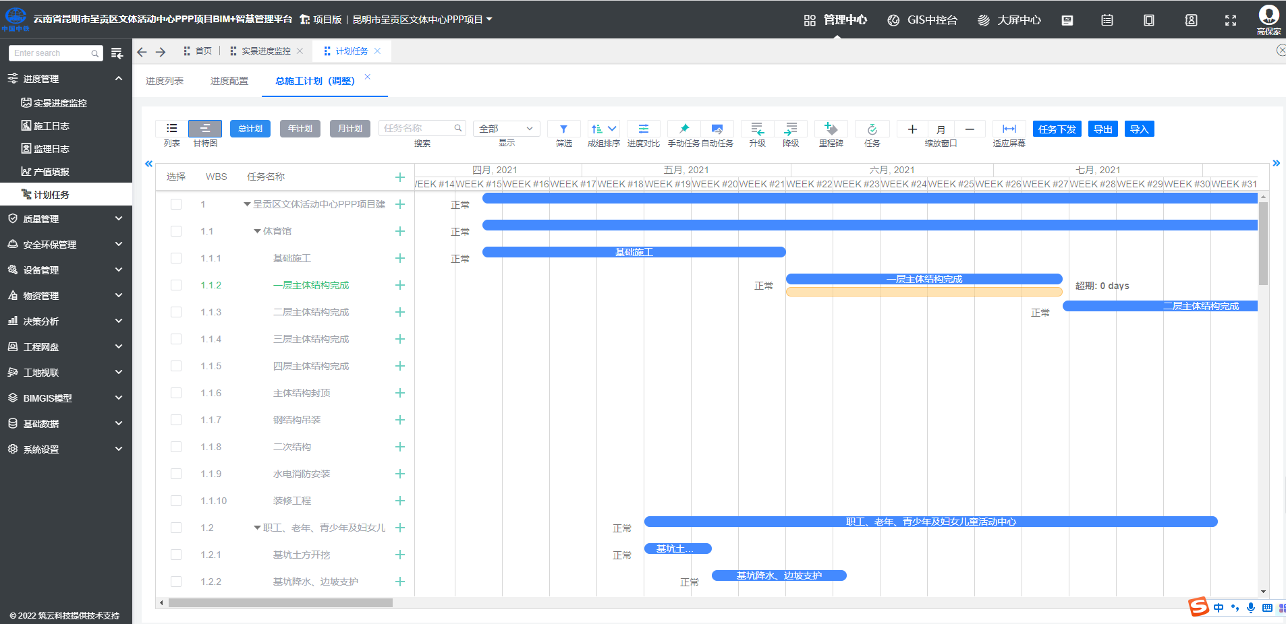
BIM+ Schedule Management
3. Prepare the schedule based on the construction management platform, hook up the BIM model, follow up the completion progress every week, monitor whether the on-site progress meets the plan requirements, reflect the schedule deviation and correct the deviation in time to ensure that the construction period goal is achieved.
Progress control: 1. Before implementation, use drone scanning to form an oblique photography model to truly restore the actual environmental status around the project. According to the construction organization and planning, the functional area and flow section are divided. Reasonably optimize the site layout and the construction sequence of the flow section, complete the dynamic field layout analysis and integration simulation. 2. Use BIM software to connect the schedule with the model, deduce the overall construction of the project.

Slide 4
BIM + Quality Management
1. Through the 3D laser scanner, the on-site construction point cloud data can be quickly obtained, the construction error of the main structure can be quickly detected, the BIM model can be modified to ensure the consistency between the BIM model and the site.
2. In the implementation stage of the on-site pipeline, the model is imported into the mobile terminal equipment, and the on-site QR code assists in positioning, the on-site construction quality inspection is carried out. Follow up and participate in the on-site construction disclosure and process quality monitoring throughout the process.
Use 3D scanning to scan the site found that the site reserved and embedded locations of 4×SC50 and 2×SC32 were inconsistent with the BIM model
High-precision reserved opening quality acceptance

Slide 5
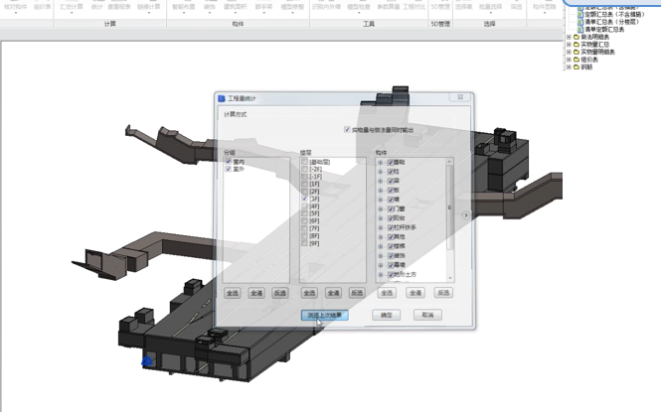
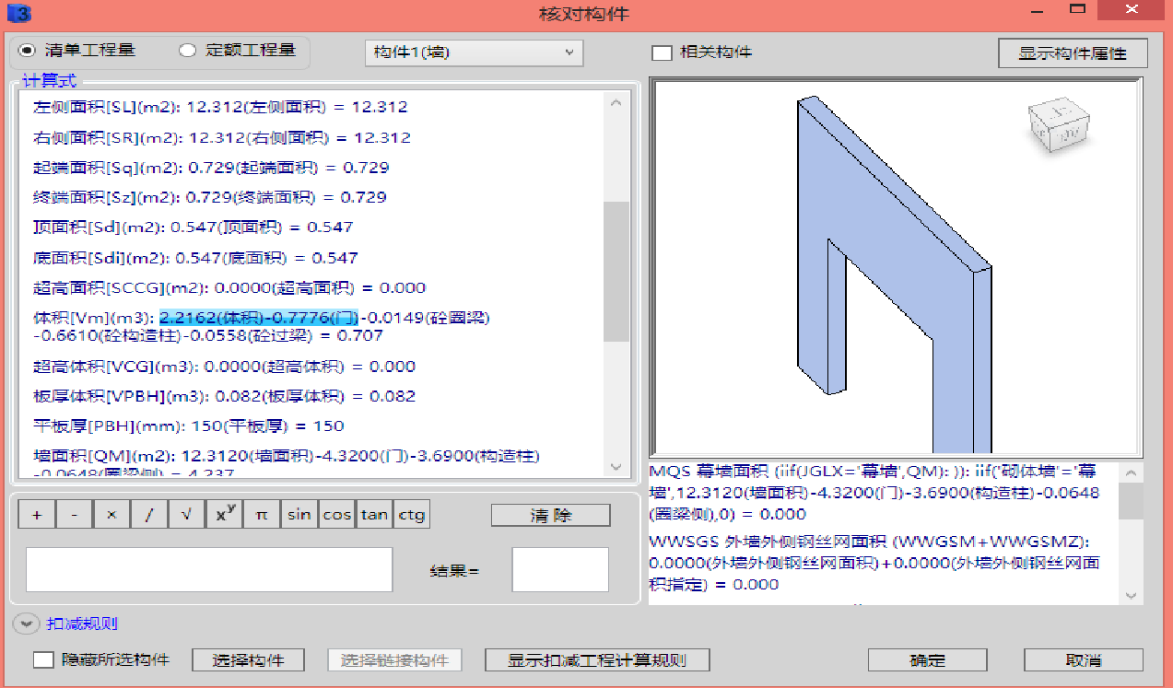
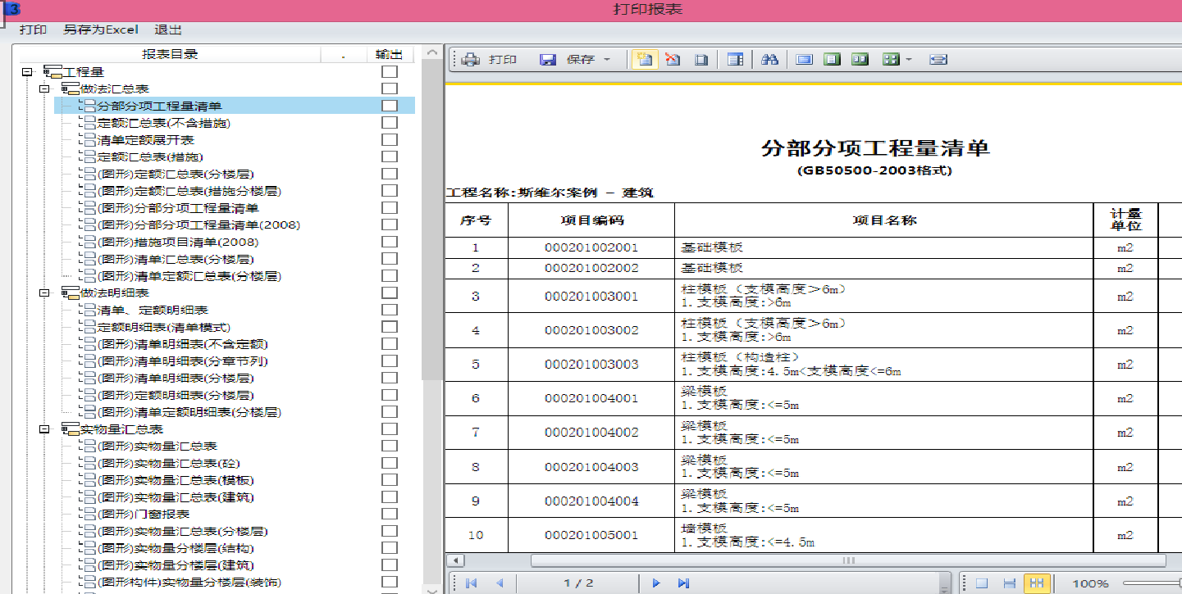
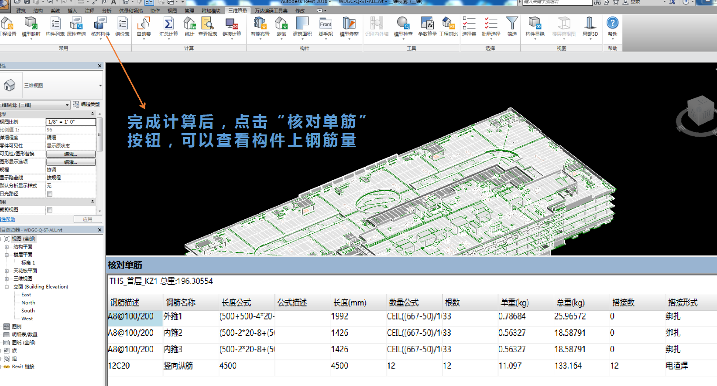
BIM + Cost Management
Calculate summaries
Data Management Material Management Settlement Approvals BIM model Engineering quantities Engineering Quality inspection Schedule/Cost Integration Investment Analysis Change Management Contract Management
Design and Construction BIM model
BIM model of Cost Takeoff
Cost Inventory Report
BIM integrated management system
Model mapping
Based on BIM takeoff tools
Based on the cost management module of the BIM platform, the whole process of cost integration management is realized, including BIM image progress approval, 5D integration, material tracking, material actual plan comparison, investment analysis and comparison, change management, bidding assistance, settlement management, etc. This stage of the work is jointly completed by Party A's management team, BIM consultants, construction units, cost consulting units, and supervision units.
The BIM consulting unit is deepened from the design model to the takeoff model, and the model depth is LOD400. The BIM consulting unit completes the review and mapping of the takeoff model, and completes the BIM-based quantity statistics together with the cost unit.

Slide 6
BIM + cost management
Value: Based on the BIM model, it provides back-to-back review of engineering quantity reports and uses the platform to fill in the real-time progress to control the random reporting and overreporting of progress, and the data source is authentic and reliable. At the same time, it can truly control the investment situation, can have a more scientific guidance basis for future capital arrangements. At the same time, it is also a compliance protection for Party A.
If the difference in the report comparison exceeds the error range, the comparison will be made item by item, and the new calculation will be checked.
Verify On-site Progress
On-site Image Progress Verification
Monthly Progress Quantity Statistics
Review of Monthly Progress Reports
Supervision unit
Cost unit
Comparative Analysis
Construction Month Image Progress Report
Construction unit
The report comparison is within the margin of error
Verification of The Progress of The BIM Plan Image
BIM Monthly Progress quantity statistics
BIM Monthly Cost Analysis Report
BIM Consultant
BIM Consultant
The Image Progress Report was Approved
BIM dynamic cost control process during construction phase

Slide 7
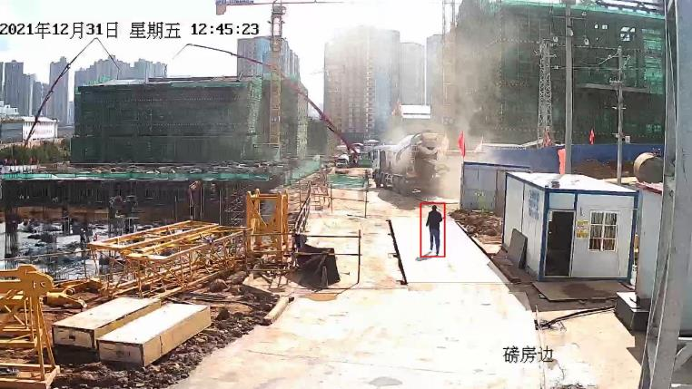
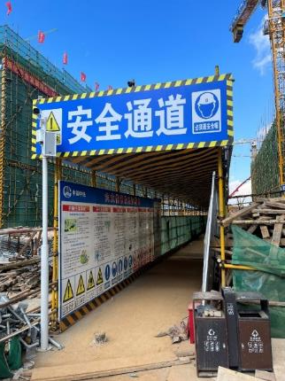
BIM + Security Management
3. Through the AI recognition module, real-time identification of violations such as not wearing safety helmets and reflective vests, and on-site broadcasting for intelligent alarm prompts, realizing unmanned supervision and efficiently avoiding safety accidents caused by labor workers not wearing safety helmets.
In addition to regular safety education, the project builds a project BIM-VR safety experience education and physical safety experience system to enhance workers' safety awareness.
Build a BIM construction safety measures model, conduct hazard source investigation, meet the requirements of normalized inspection of hazard sources, reduce potential safety hazards.

Slide 8
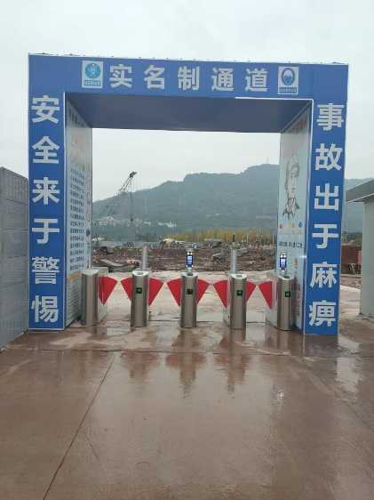
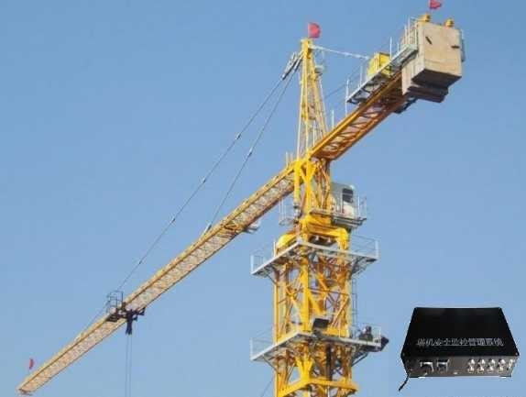
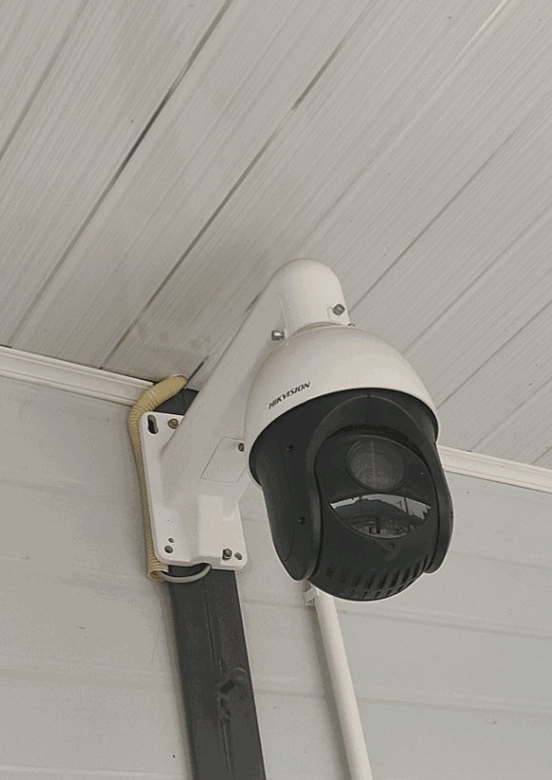
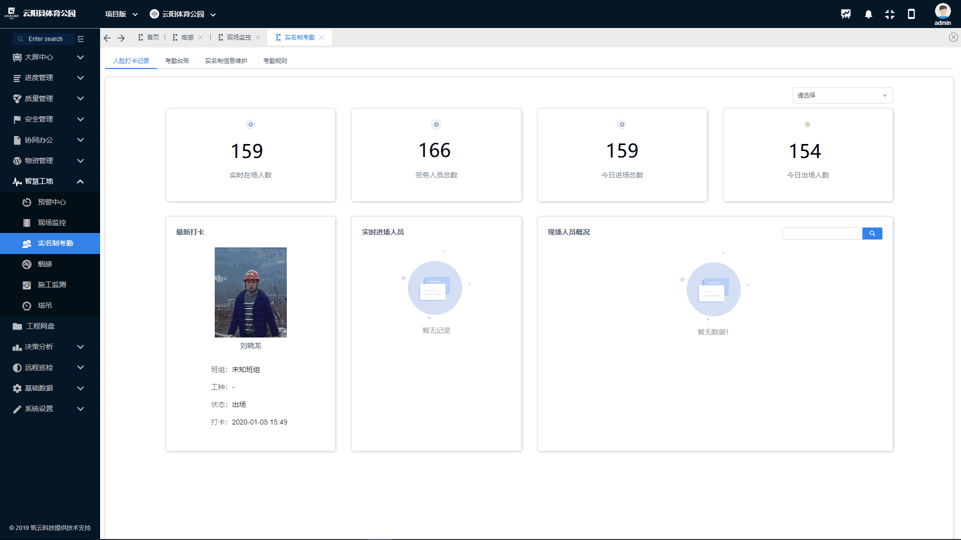
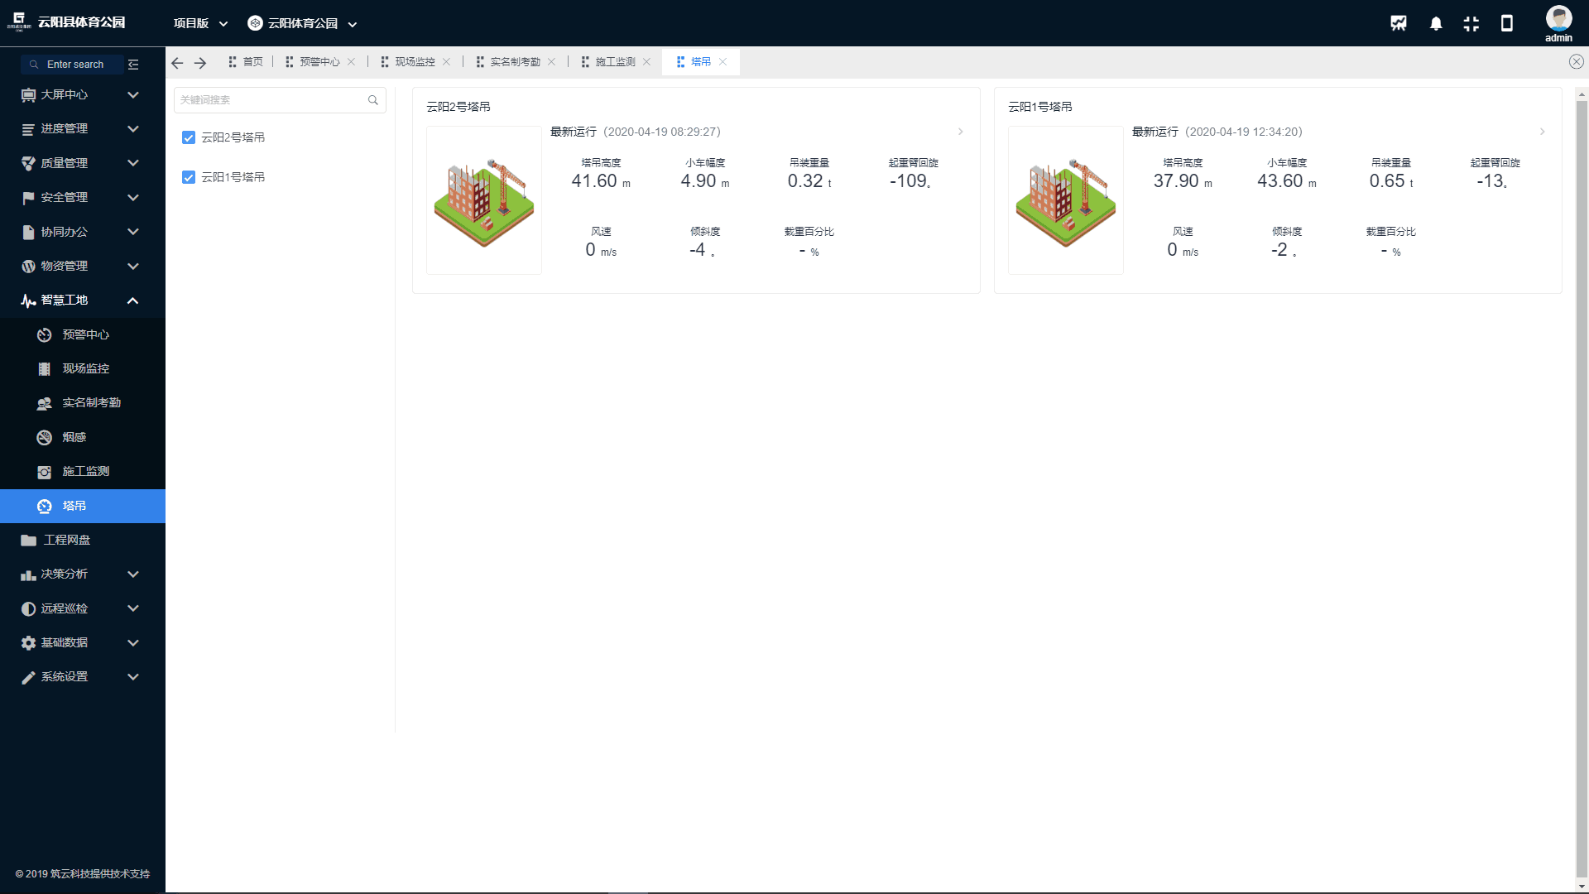
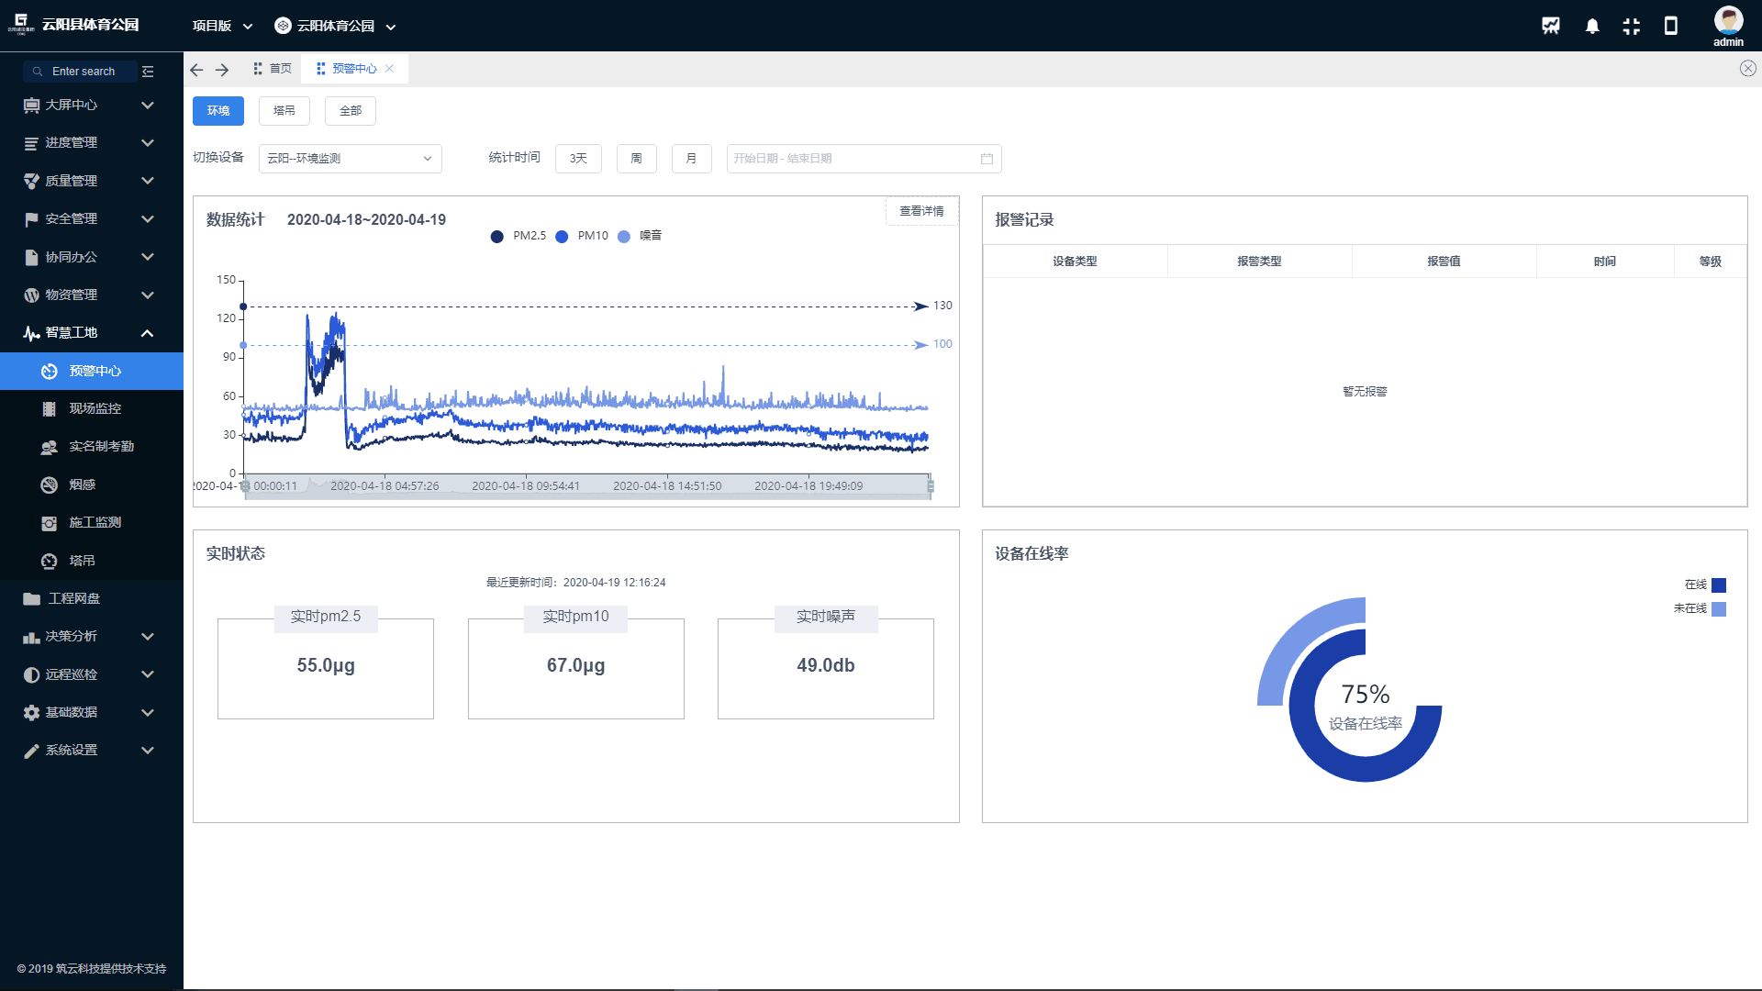
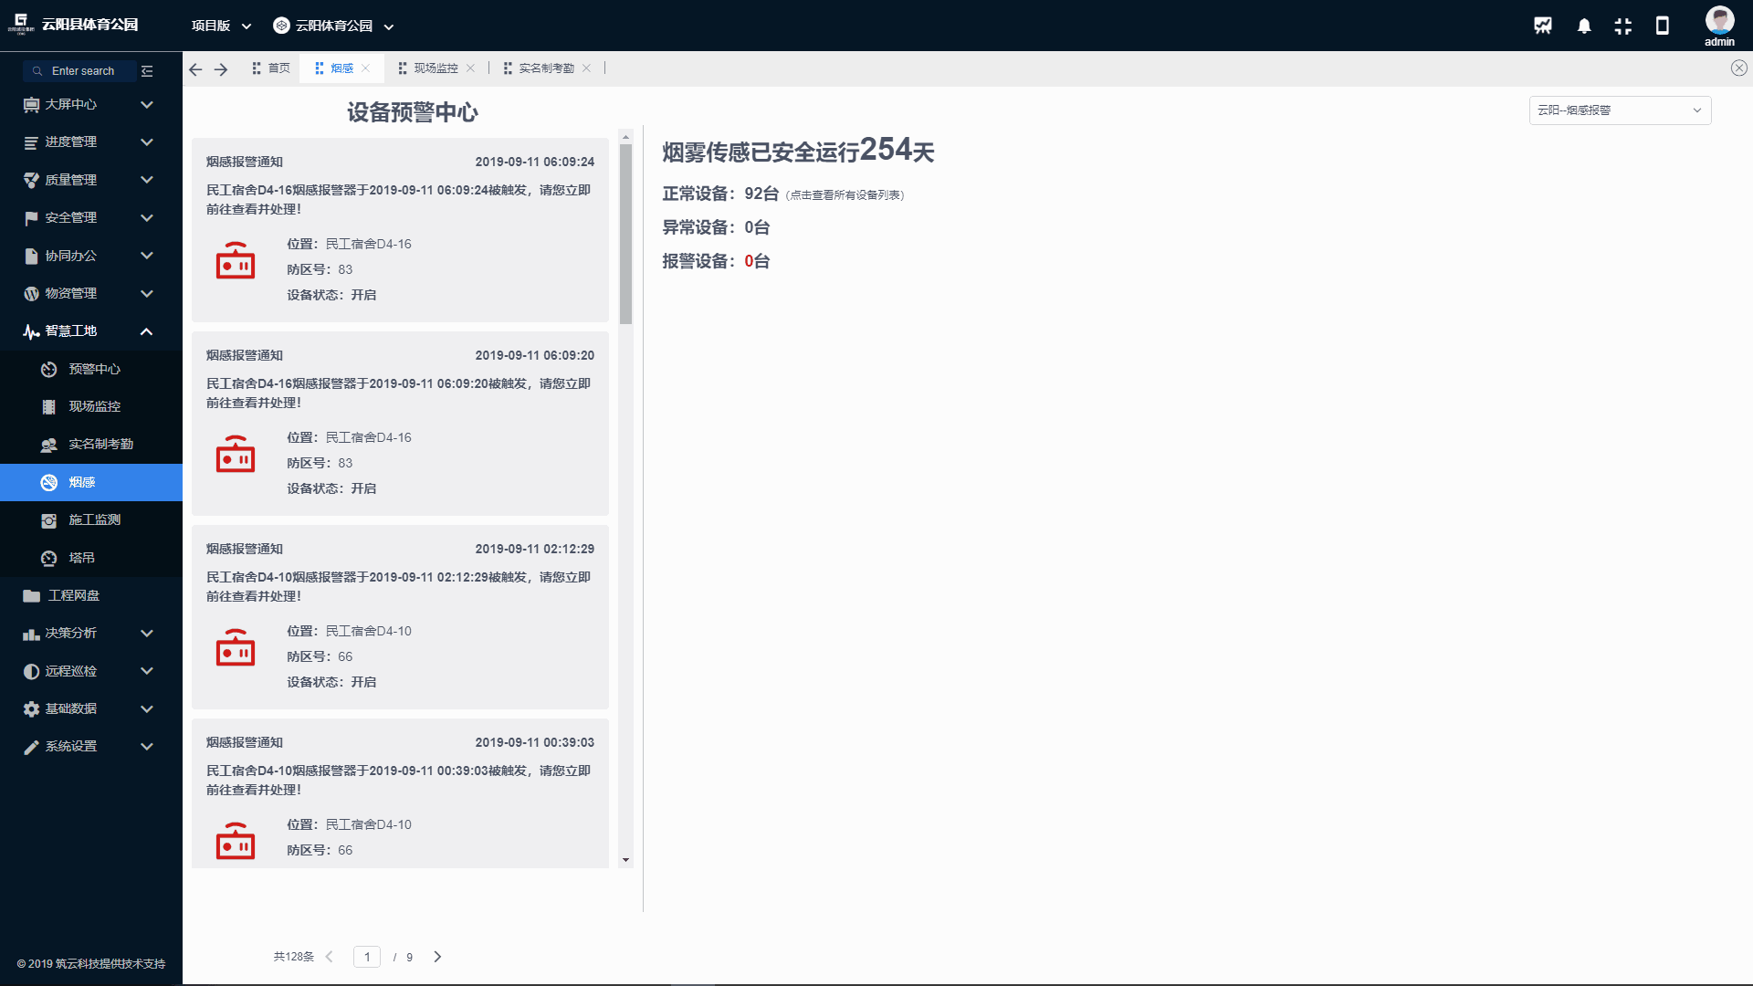
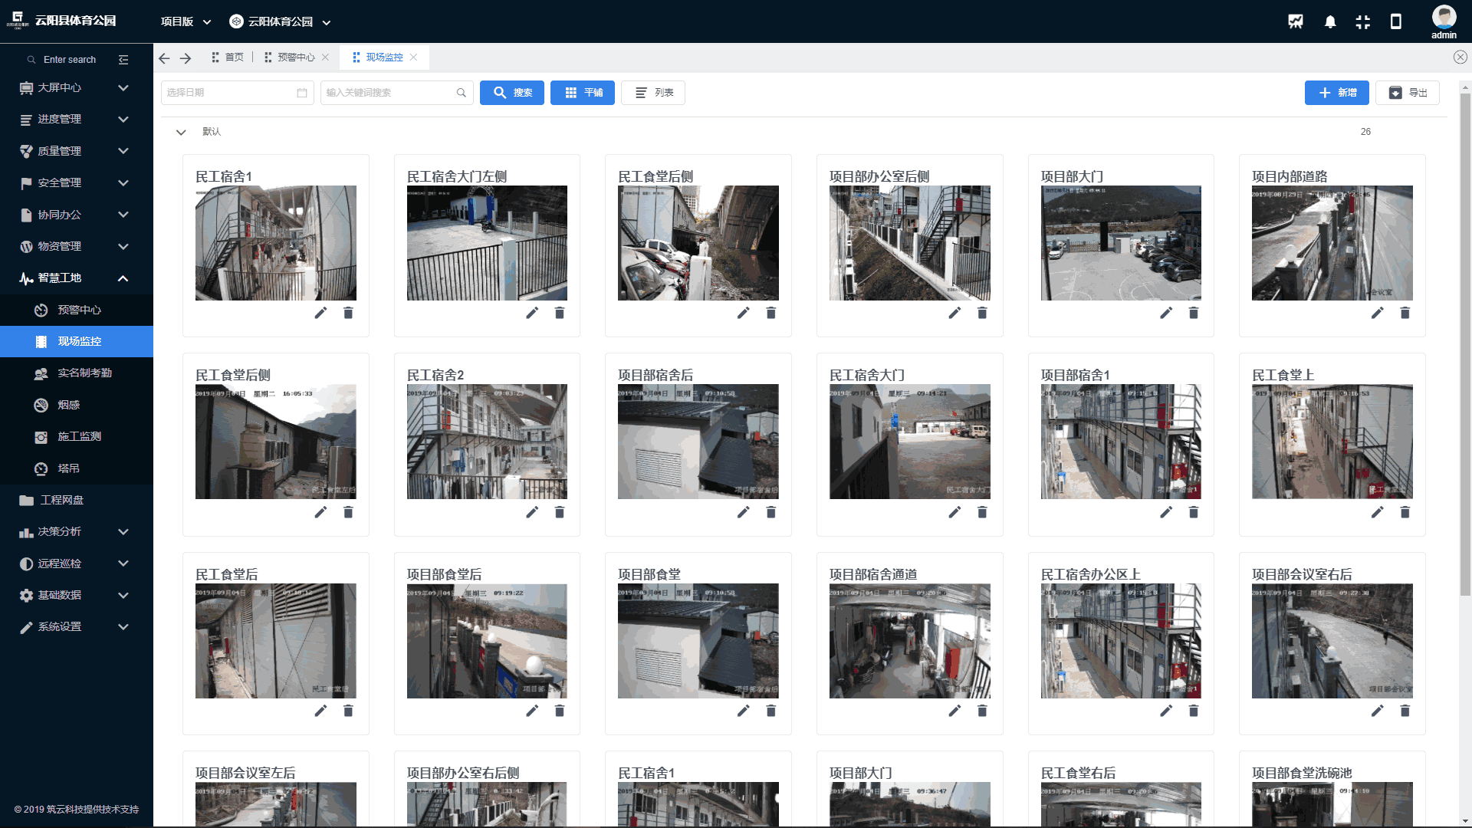
BIM + Smart Site Management
Through the information docking of various systems of the smart construction site, the video surveillance, tower crane monitoring, and environmental monitoring data are integrated and displayed on the smart management platform, and an early warning center is formed for data analysis. It realizes the function of multiple monitoring on one platform.
Environmental Monitoring
Smoke Alarm
Video Surveillance
Personnel Real-name System
Tower crane safety monitoring

Slide 9
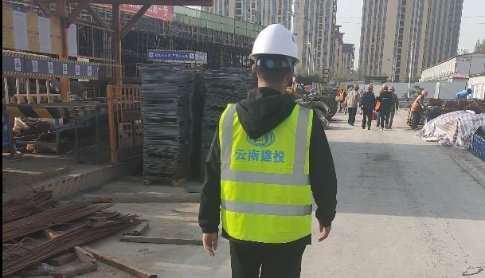
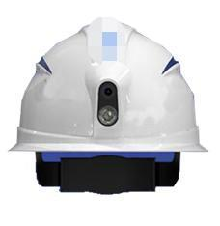
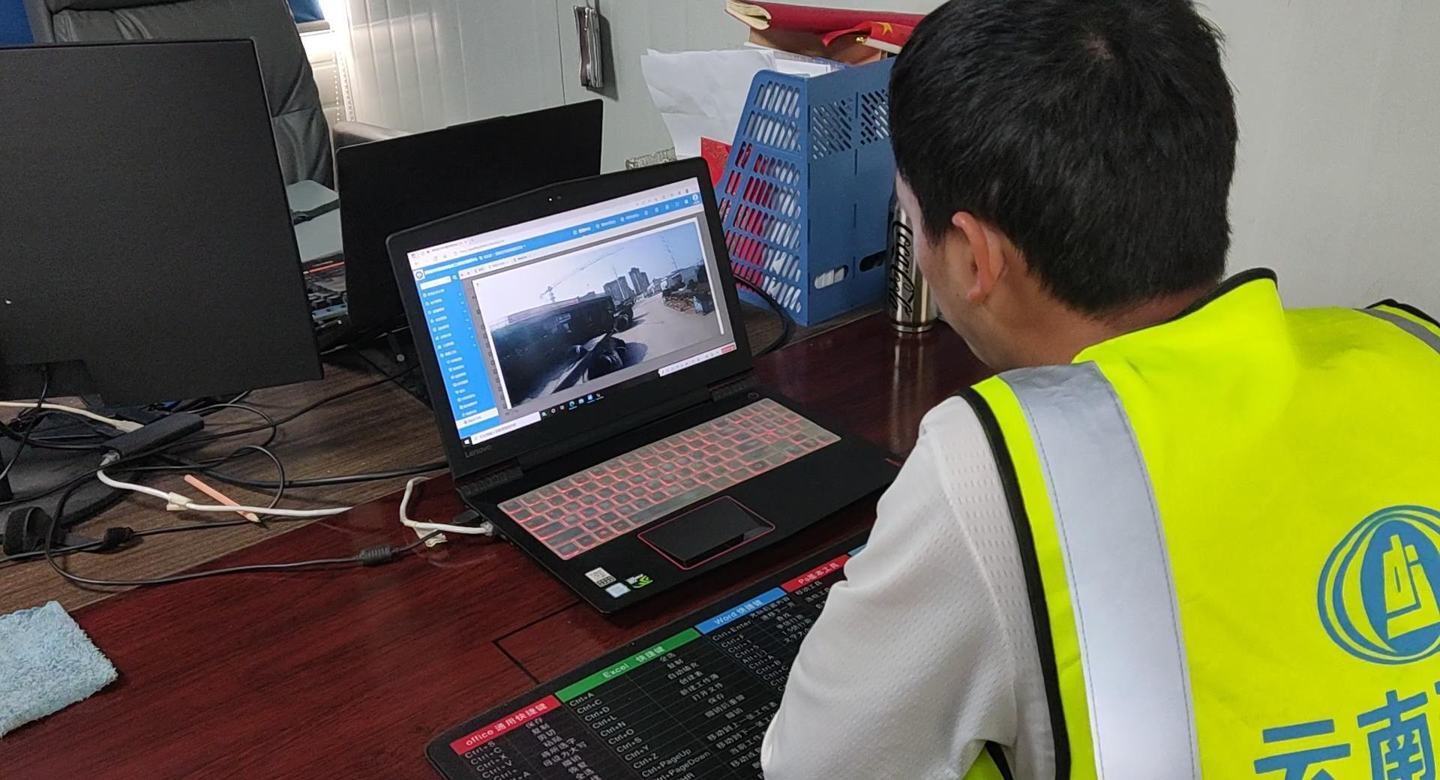
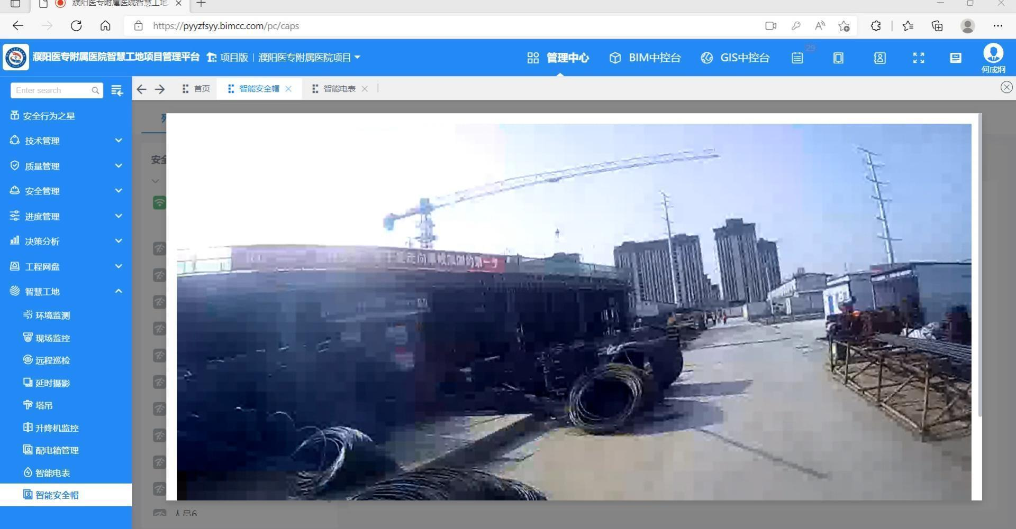
BIM + Smart Site Management
Using UWB technology, combined with electronic fence technology, to achieve the precise positioning of operators/managers. Based on the positioning data, on-site real-time inspection and real-time positioning and shouting are realized, the individual combat system is used to provide precise control means for visual rapid scheduling, emergency early warning processing and one-click alarm.
Individual combat helmets are worn
Individual Combat Helmet
Remote real-time calling
The platform can be viewed anytime, anywhere

Slide 10
Digital Construction Command Center
Establish a smart construction command center to integrate the management data of our project and the Internet of Things data to achieve all-round real-time dynamic management, risk management and control, and intelligent decision-making.
The project information command center was built on site, which was used for on-site smart site management and control, effect display and other office spaces in the early stage. Realize the function migration from construction to operation and maintenance, realize the continuity of some hardware.
Based on the construction data of the construction platform and the intelligent hardware data, it realizes all-round real-time, management traces and intelligent decision-making, realizes the all-round management of the project. Dynamic management and risk control.

